Slide 1
RAG
Retrieval Augmented Generation

Slide 2
Topics
Introduction
RAG Architecture
Main Components of RAG

Slide 3
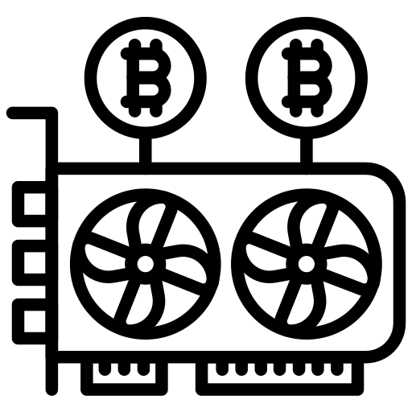




Number for Llama 2 7B
Chunk of the internet
~10 TB of text
6000 GPUs for 12 days, ~$2M
~140GB Model
Intro to Large Language Models- Anderj Karpathy

Slide 4
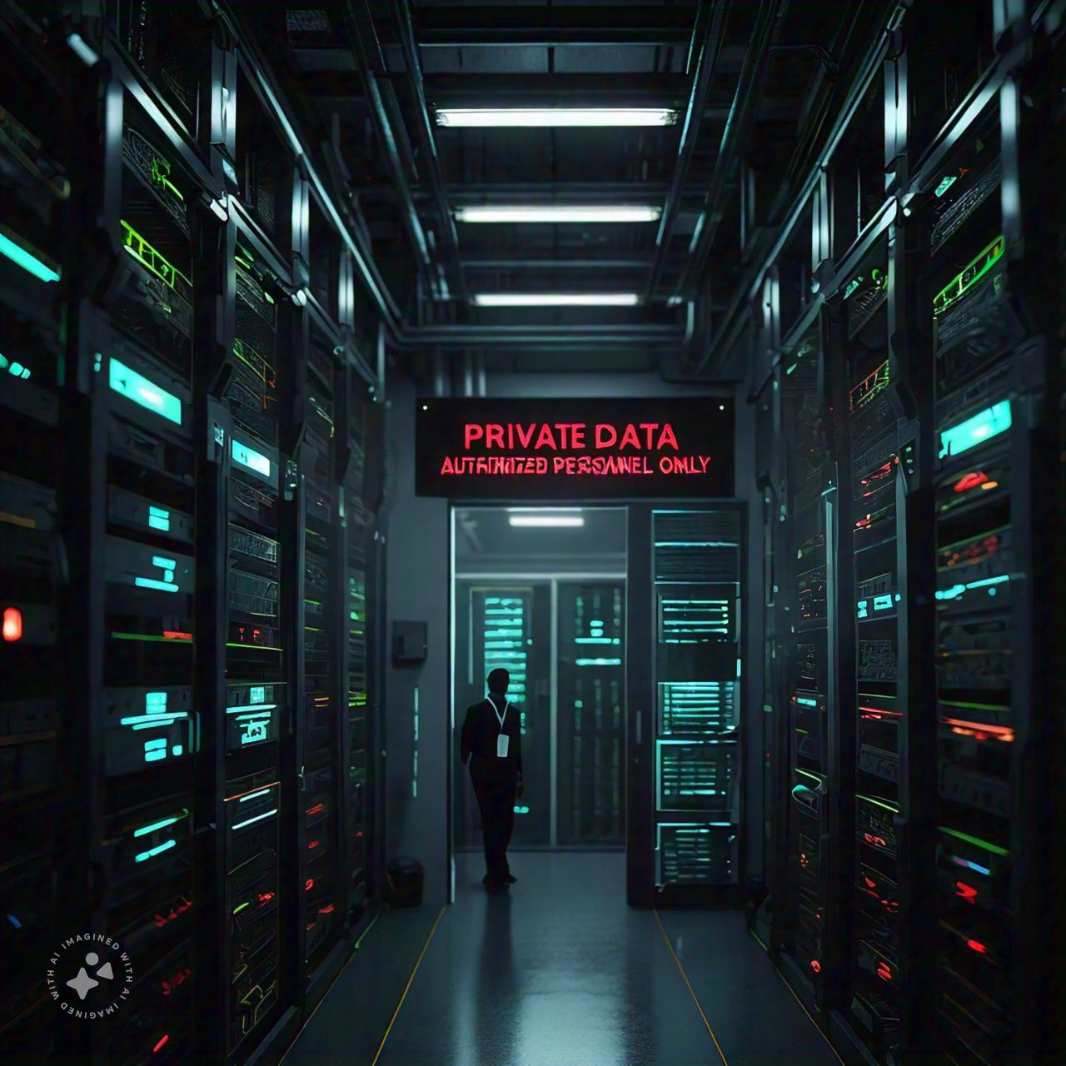
> 95% of data is private
How to feed it into the model
Notes:
Given that 95% of the data you work with is private, it's especially crucial to be vigilant about LLM hallucinations, as any misrepresentation could have serious implications.
When developing or utilizing LLMs, incorporating retrieval-augmented generation (RAG) systems can help mitigate these risks by grounding responses in verified, private data sources.
This ensures that the model generates more accurate and contextually appropriate outputs.

Slide 5


Hallucination

Slide 6

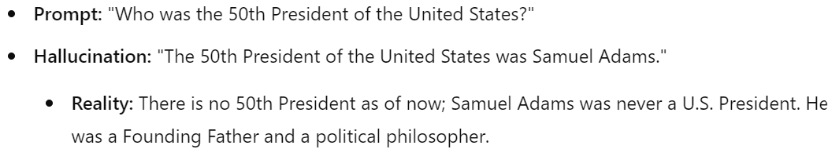
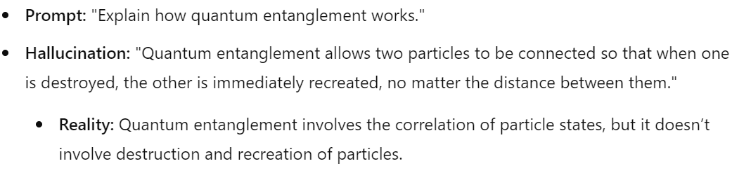

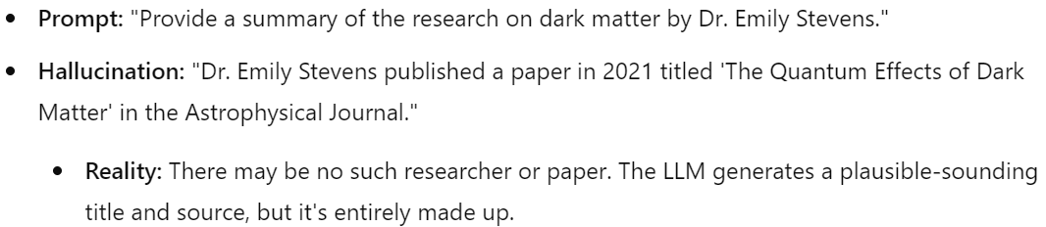
Hallucination

Slide 7


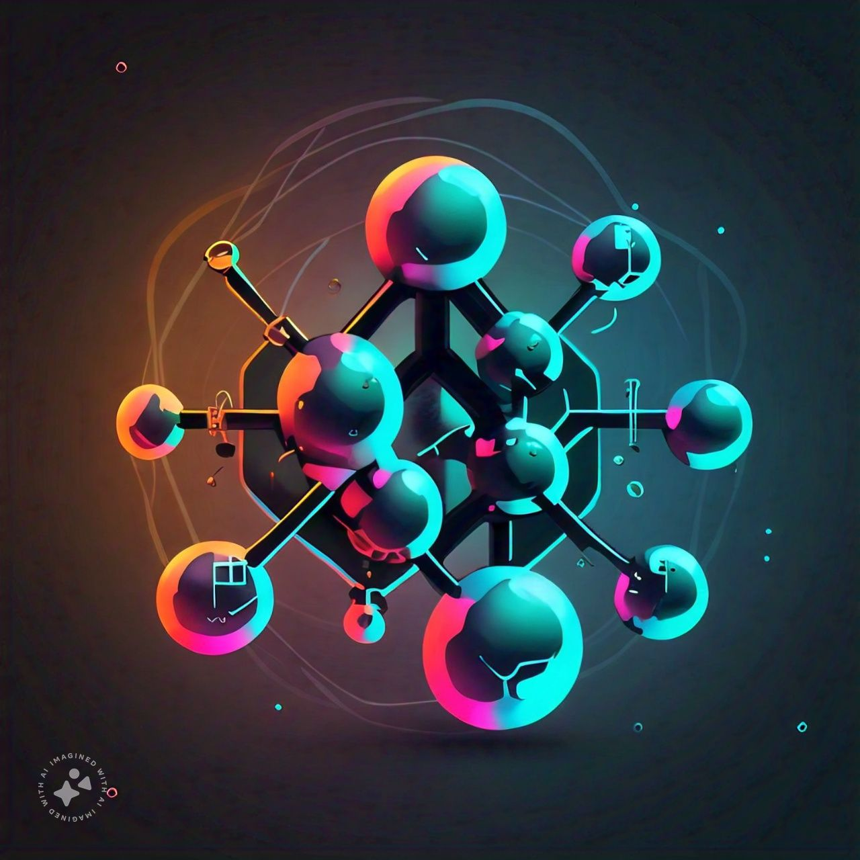

How about more recent data that model was not seen?

Slide 8
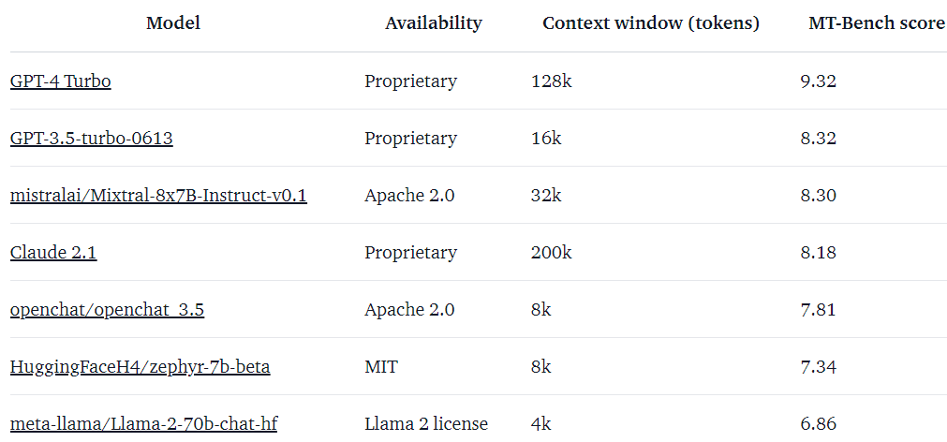
Model are getting better and have higher context length
https://huggingface.co/blog/mixtral

Slide 9


RAG

Slide 10
RAG
Chunks
Chunk a,b,c
Chunk d,e
Prompt
api calls
api calls
Query: Which dragon did Jon Snow ride
LLM

Slide 11
RAG
Chunks
Prompt
Query = Which dragon did Jon Snow ride?
+ Context =
api call
LLM

Slide 12
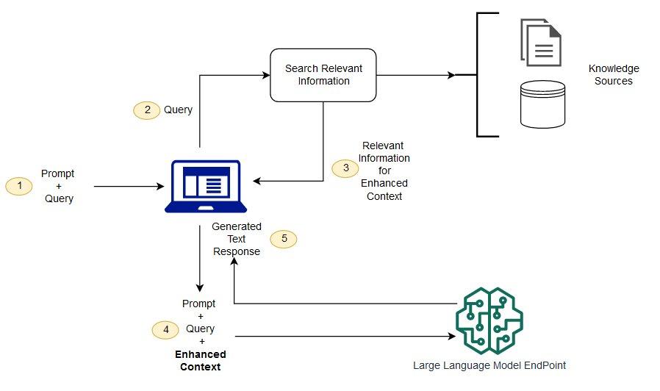
RAG
https://docs.aws.amazon.com/sagemaker/latest/dg/jumpstart-foundation-models-customize-rag.html

Slide 13
Main Component of RAG
Data Chunking
Embedding
Indexing

Slide 14

Data Chunking
Chunking is the process of breaking down large documents or data into smaller, manageable pieces (chunks) that can be individually processed by models.
Challenge:
Balance between chunk size and contextual integrity—smaller chunks might miss context, larger ones may overload the model.

Slide 15
Data Chunking
Fixed-Size Chunking
Technique: Divides text into equal-sized chunks (e.g., 512 tokens).
Advantages:
Simple to implement.
Consistent chunk sizes, making it easy to process and index.
Drawbacks:
May split meaningful sentences or paragraphs, leading to loss of context.
Fixed size may not always align with natural language boundaries.

Slide 16
Data Chunking
Overlapping Chunking
Technique:
Creates chunks with overlapping regions (e.g., 512 tokens with a 50-token overlap).
Advantages:
Preserves context between chunks.
Reduces the chance of losing important information at chunk boundaries.
Drawbacks:
Increases the number of chunks to process, leading to higher computational cost.
Redundant information in overlaps might require careful handling during retrieval.

Slide 17
Data Chunking
Sentence or Semantic-Based Chunking
Technique:
Chunks are created based on natural language boundaries like sentences or paragraphs, or by grouping semantically related content.
Advantages:
Preserves the meaning and context of the content.
More intuitive and aligns with natural language processing tasks.
Drawbacks:
Chunks can vary in size, complicating processing and indexing.
May still require post-processing to handle large chunks.

Slide 18
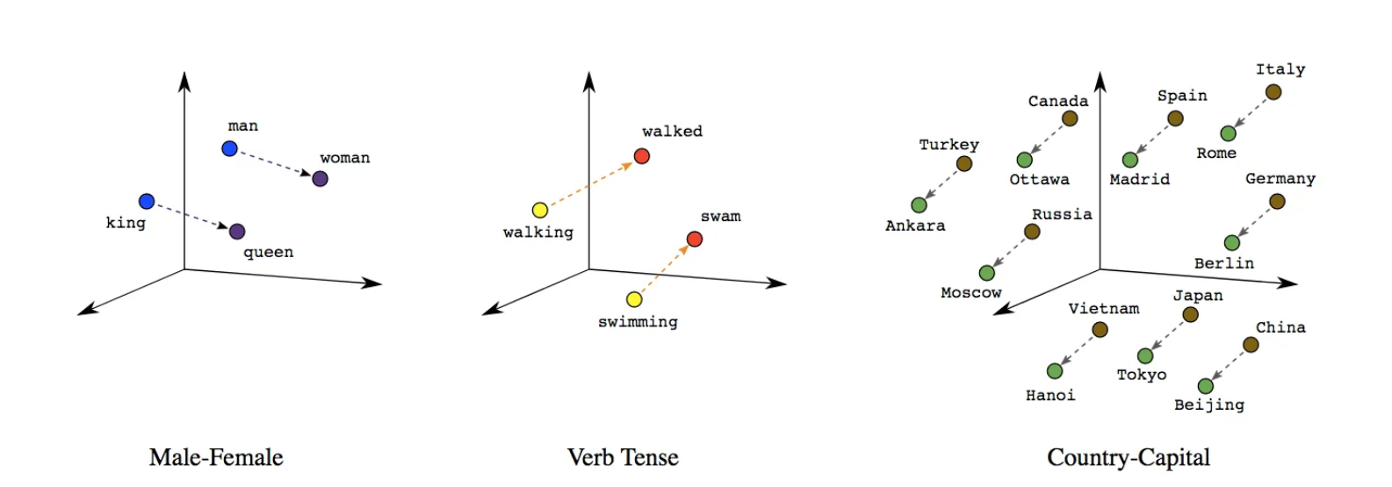
Embeddings

Slide 19
Embeddings
king – man + woman = queen

Slide 20
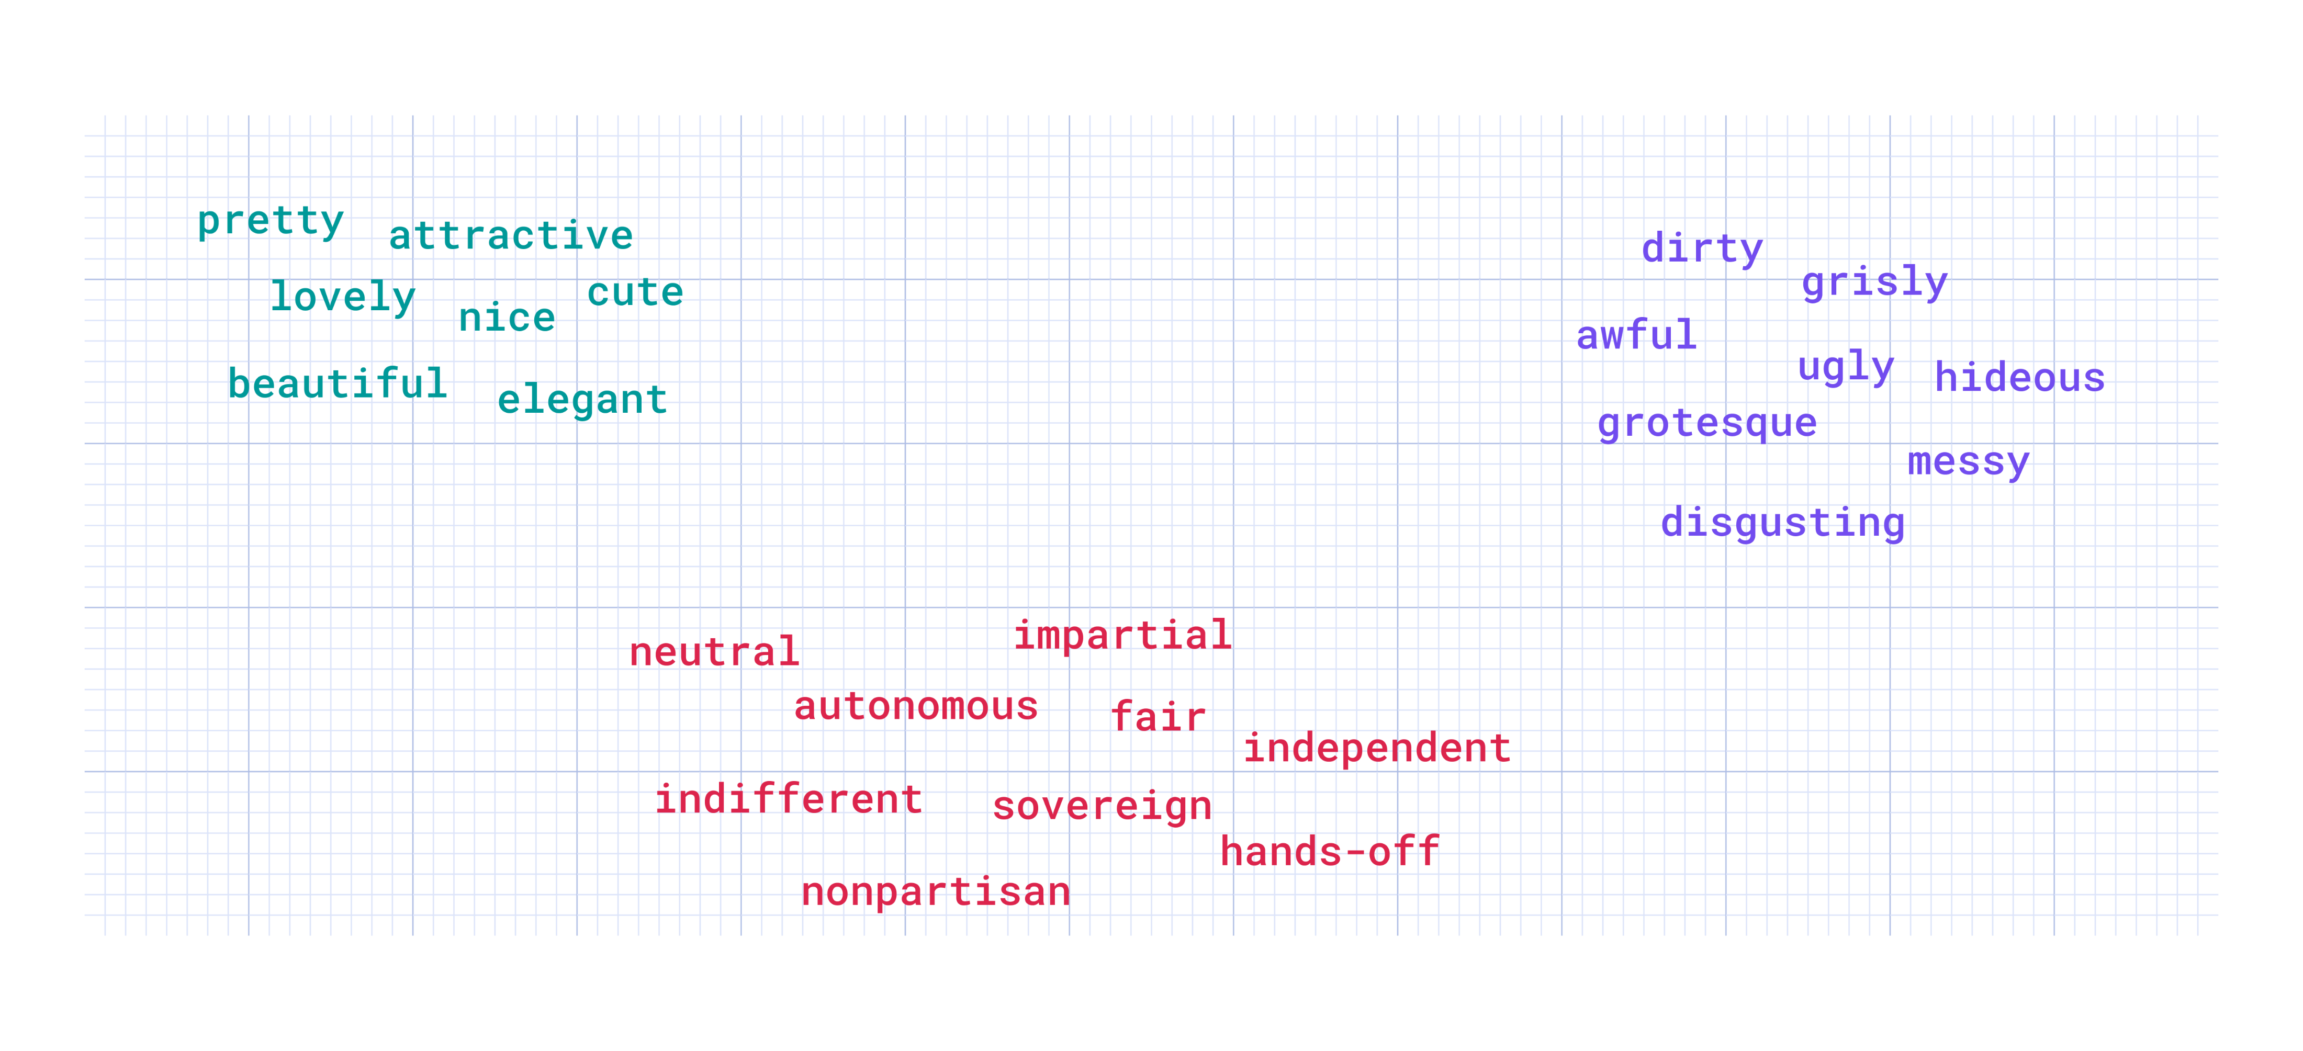
Embeddings

Slide 21
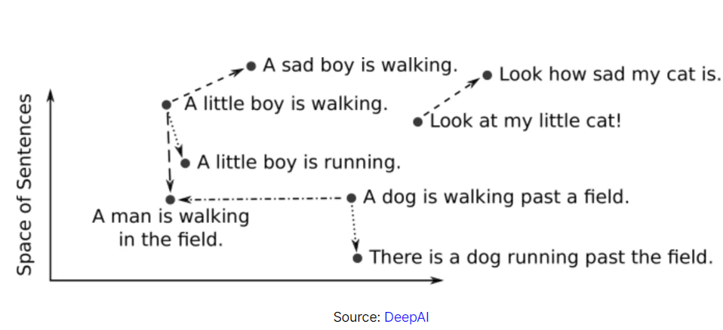
Embeddings

Slide 22
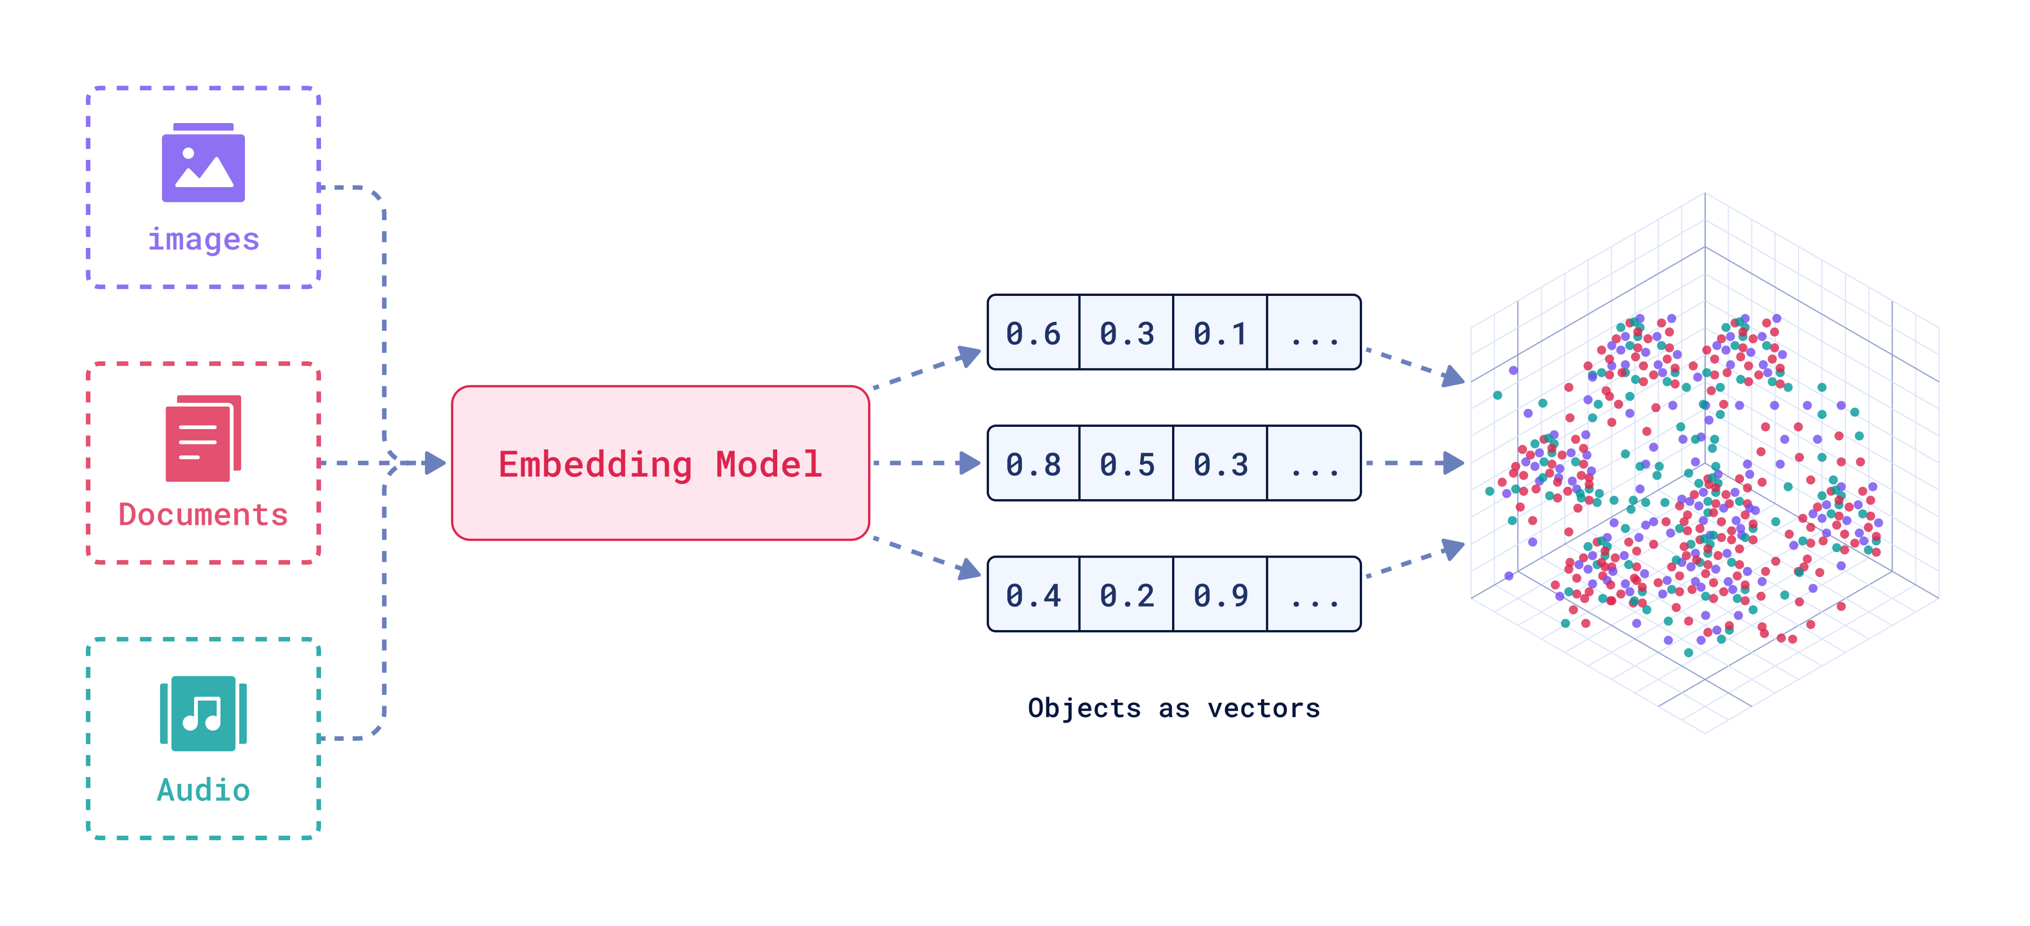
Embeddings
Embeddings

Slide 23
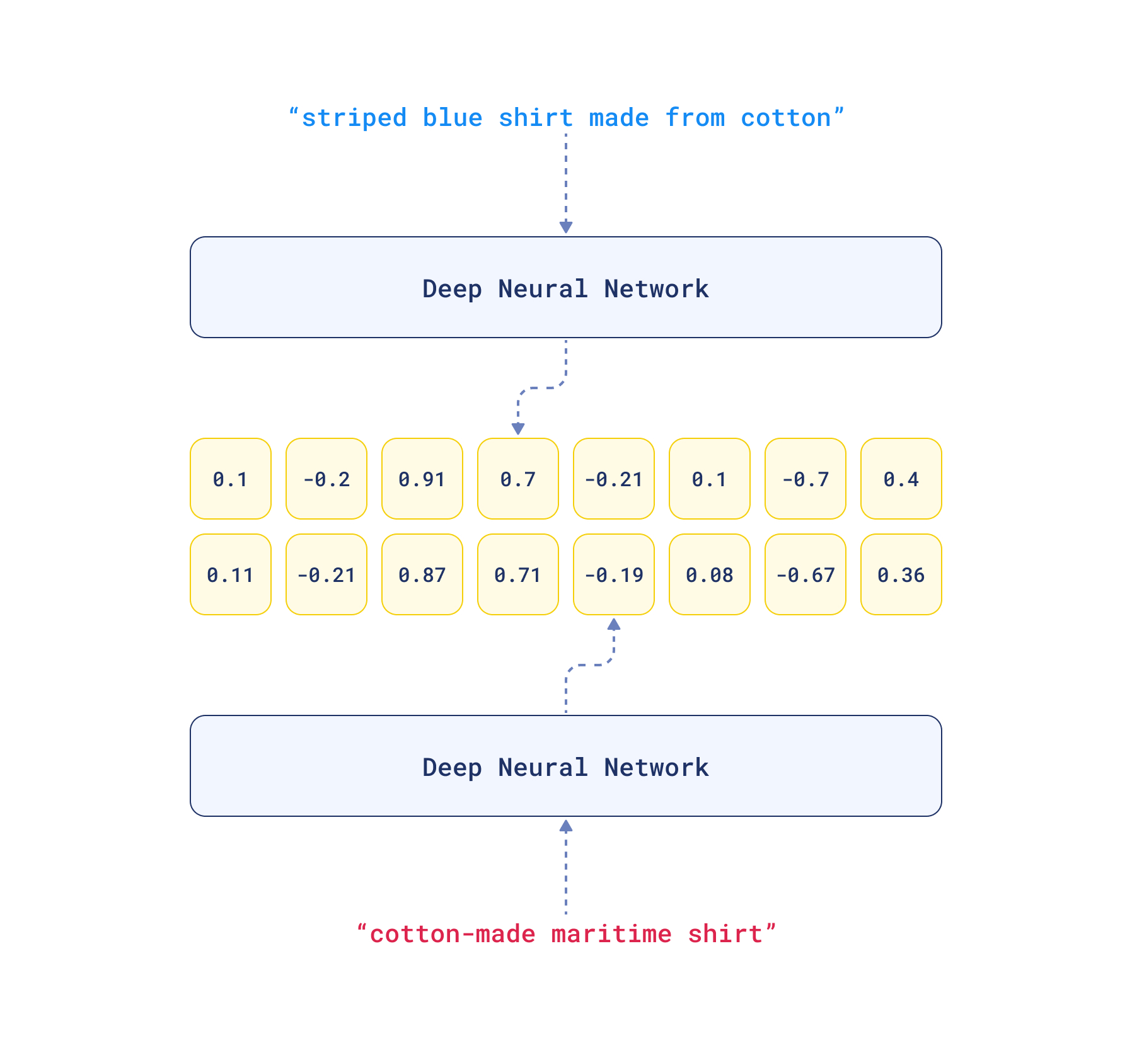
Embeddings

Slide 24
Indexing
Technique:
Indexing involves organizing and storing data (or vectors) in a way that allows for fast and efficient retrieval.
Importance in RAG:
Critical for quick access to relevant information in large datasets, enhancing the speed and accuracy of responses.
Focus:
Overview of key indexing techniques and vector databases commonly used in RAG systems

Slide 25
Indexing
Inverted Indexing
Technique:
Maps terms to the documents they appear in, allowing for quick lookup of documents containing specific words or phrases.
Advantages:
Highly efficient for text-based search.
Scales well with large datasets.
Drawbacks:
Less effective for semantic search, as it relies on exact term matching.
Requires significant preprocessing and storage for large corpora.

Slide 26
Indexing
Vector Indexing Techniques
Overview:
Vector indexing involves creating embeddings (dense vector representations) of data points and indexing them for similarity search.
Techniques:
Brute Force Search:
Compares query vector with all stored vectors.
Pros: Exact results.
Cons: Computationally expensive, not scalable.
Approximate Nearest Neighbors (ANN):
Uses algorithms like HNSW (Hierarchical Navigable Small World) or Faiss for efficient, approximate search.
Pros: Much faster, scalable to large datasets.
Cons: Might return approximate, rather than exact, matches.

Slide 27
Indexing
Vector Databases
Overview: Vector databases are specialized databases designed to store and search large-scale vector embeddings.
Popular Options:
Faiss (Facebook AI Similarity Search):
Features: Highly optimized for efficient similarity search, supports various indexing methods.
Use Case: Large-scale similarity search in production environments.
Milvus:
Features: Open-source, highly scalable, supports hybrid search (both vector and traditional).
Use Case: Suitable for both small-scale and large-scale RAG systems, versatile in application.
Pinecone:
Features: Managed service, integrates easily with other ML/DL pipelines, optimized for real-time applications.
Use Case: Ideal for cloud-based RAG systems with real-time requirements.
Considerations: Choice depends on the scale, latency requirements, and specific use cases of your RAG system.

Slide 28
Type of Data Infusing in RAG
Overview: Databases store structured data in organized formats like tables. In RAG, databases provide reliable and structured information that can be easily queried and integrated into responses.
Key Points:
Structured Data: Ideal for retrieving specific, organized data such as user records, product details, or transaction histories.
Query Methods: SQL-based queries to extract relevant data.
Use Cases: Customer support bots accessing user profiles, financial data retrieval, product information systems.
Challenges:
Requires well-defined schema.
Ensuring real-time access to frequently updated data.

Slide 29
Infusing Data from Documents in RAG
Overview:
Documents contain unstructured or semi-structured data in the form of text, PDFs, or other files. RAG systems can extract relevant information from large volumes of documents.
Key Points:
Unstructured Data: Handles a wide range of formats like PDFs, Word documents, and text files.
Processing Techniques: Chunking, OCR (Optical Character Recognition) for scanned documents, and semantic search for retrieving relevant content.
Use Cases: Legal document analysis, research paper extraction, policy document search.
Challenges:
Preprocessing required for extraction and chunking.
Complexity in maintaining context across chunks.

Slide 30
Infusing Data from APIs in RAG
Overview: APIs (Application Programming Interfaces) allow RAG systems to access real-time, dynamic data from various external sources, such as weather updates, stock prices, or news articles.
Key Points:
Dynamic Data: Real-time data access, ensuring up-to-date information.
Integration: APIs can be integrated seamlessly into RAG pipelines to enrich responses with live data.
Use Cases: Chatbots providing real-time information (e.g., weather, traffic), integrating social media data, or pulling data from third-party services.
Challenges:
Handling rate limits and latency issues.
Ensuring the reliability and consistency of API responses.

